Slide 1
Fourier Series for Odd and Even Functions Simplification of Fourier series for odd functions (sine series). Simplification of Fourier series for even functions (cosine series).
Id: 13654

Slide 2
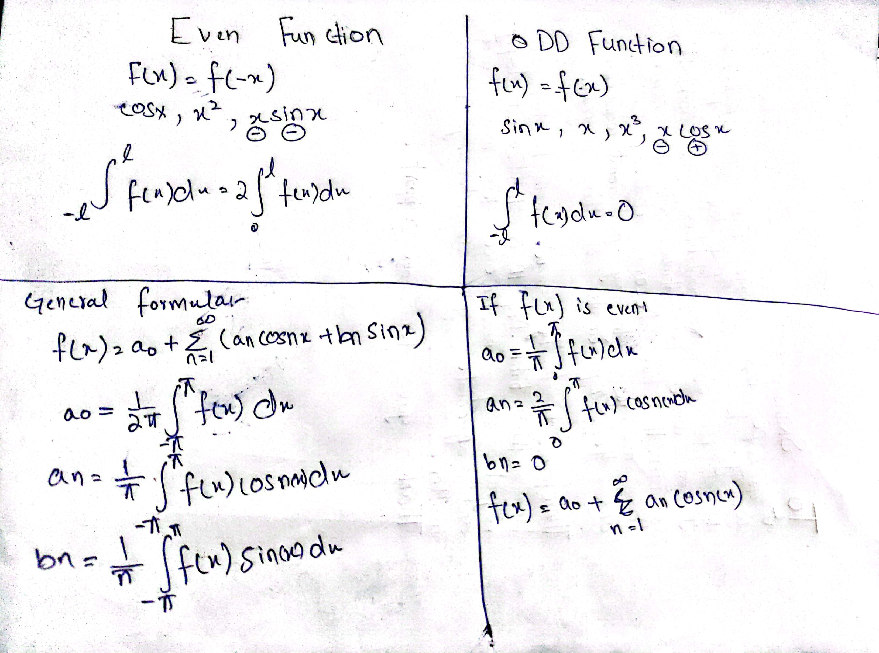
Even and Odd Function General Formula Derivation:

